Slide 1

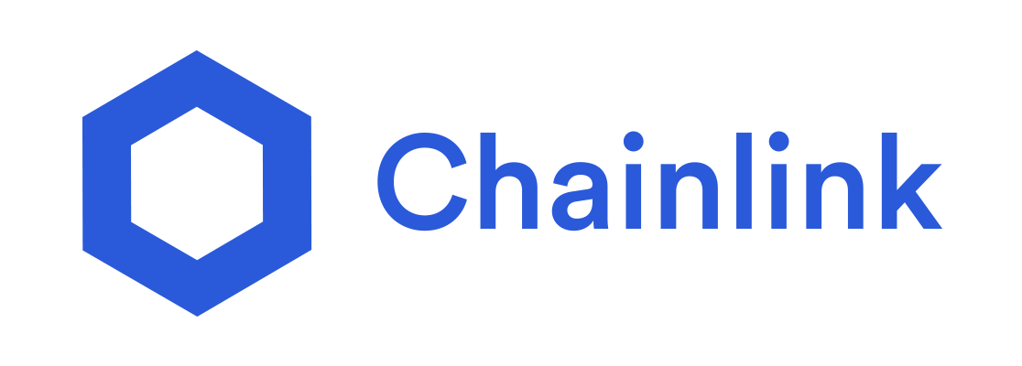



Getting started with Chainlink development
Maiko Trindade
June 2021 v1.0

Slide 2
Why
Blockchain’s inability to fetch reliable information from the real world
Huge vulnerability in decentralized applications when Blockchain wants to take advantage of off-chain data
Origins of data are also the points where data can be manipulated, compromised, or simply falsified
Chainlink started on Ethereum but it's also available on Polkadot, Hyperledger, etc...

Slide 3
Chainlink
Decentralized network of nodes that provide data and information from off-blockchain sources to on-blockchain smart contracts via oracles
LINK is built on Ethereum in accordance with the ERC-20 standard for tokens
Sep 2017 – Chainlink raises $32 million in an ICO creating 1 billion LINK tokens
Nov 2018 – Chainlink acquires TownCrier
May 2019 – Chainlink is launched on Ethereum mainnet
May 2021 – Chainlink 2.0 whitepaper

Slide 4
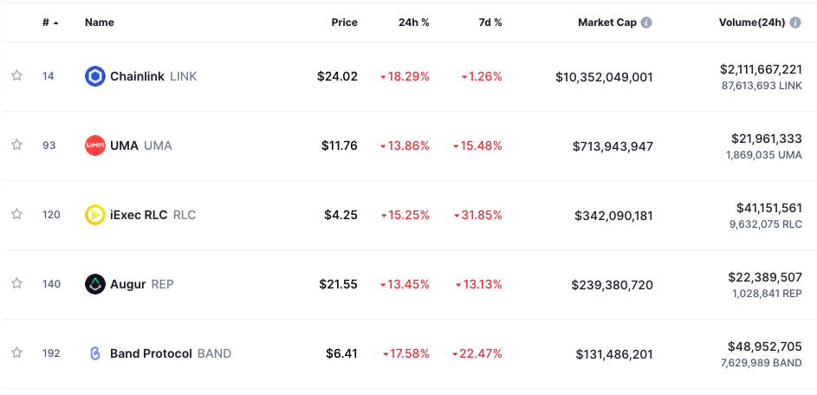
The Chainlink's oracle
Oracle – Middleware that acts as an intermediary, translating data from the real world to smart contracts on the blockchain and back again
Chainlink – Decentralized network of nodes that provide data and information from off-blockchain sources to on-blockchain smart contracts via oracles
🥇 Market standard for decentralized oracles

Slide 5
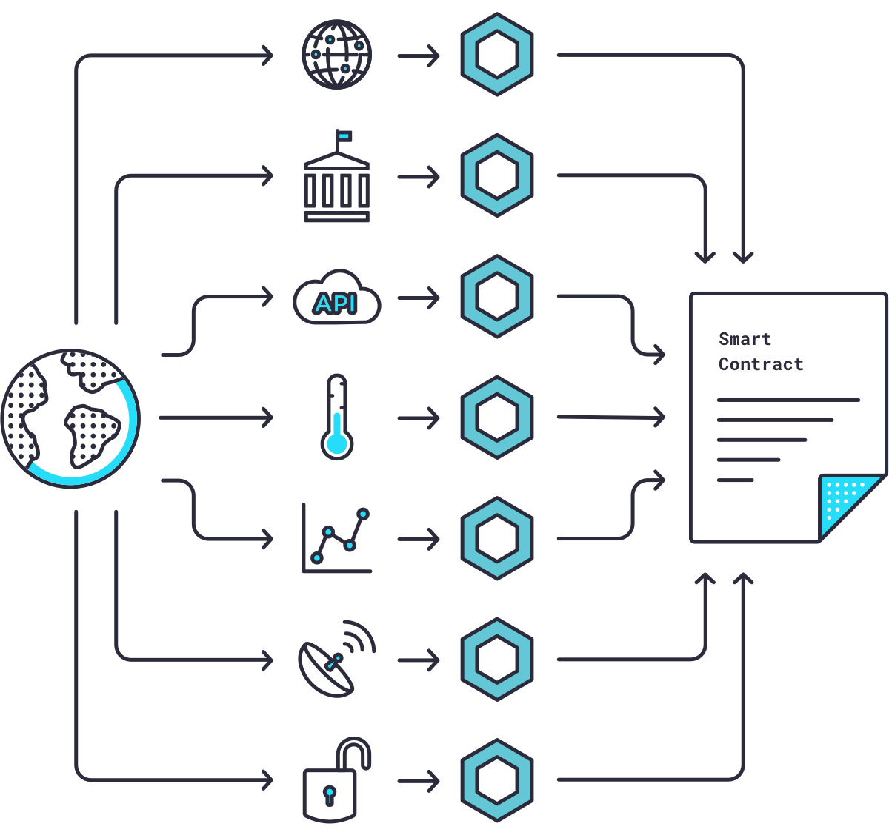
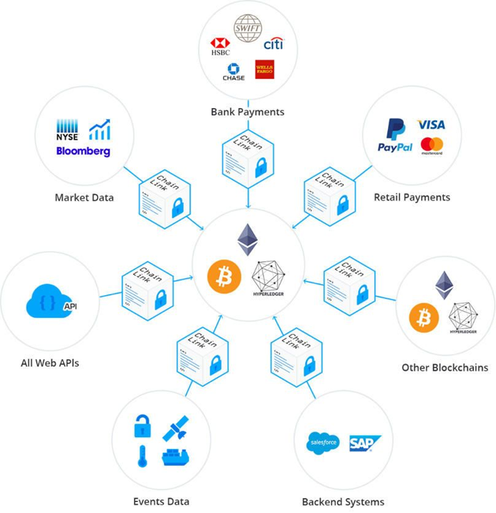
The Chainlink's oracle

Slide 6
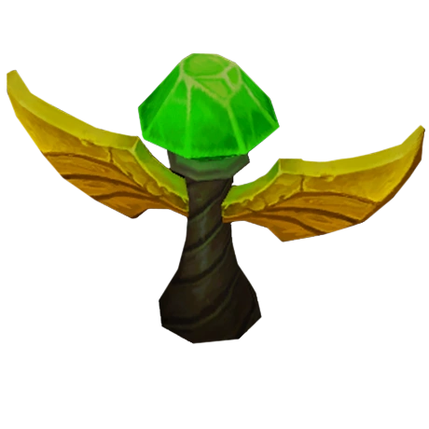
The Chainlink's oracle
✅ Enhance and extend the capabilities of smart contracts on a target blockchain through functions that are not available natively
✅ To minimize the potential failure of oracles: Distribution of data sources, Distribution of oracles and Use of trusted hardware
✅ The Chainlink Reputation Contract

Slide 7
Chainlink 2.0
Chainlink 2.0: Next Steps in the Evolution of Decentralized Oracle Networks
"Oracle networks go far beyond delivering highly validated data, they provide the various decentralized services that are combined with smart contracts to create real world outcomes. These hybrid smart contracts are already redefining our industry as DeFi."
🔥 Hybrid Smart Contracts that are seamlessly connected to all necessary off-chain resources, while retaining increased levels of privacy and being secured
🔥 New "architecture" enables more advanced off-chain computation
🔥 Increase number of services since ecosystem is more flexible and enhance its capabilities. Chainlink is the future of DeFi

Slide 8

Hands on: Truffle + Chainlink
Prerequisite: Truffle/Ganache setup
Repository: https://github.com/smartcontractkit/truffle-starter-kit
npm install --global yarn
mkdir Chainlink
cd Chainlink
truffle unbox smartcontractkit/box
yarn

Slide 9
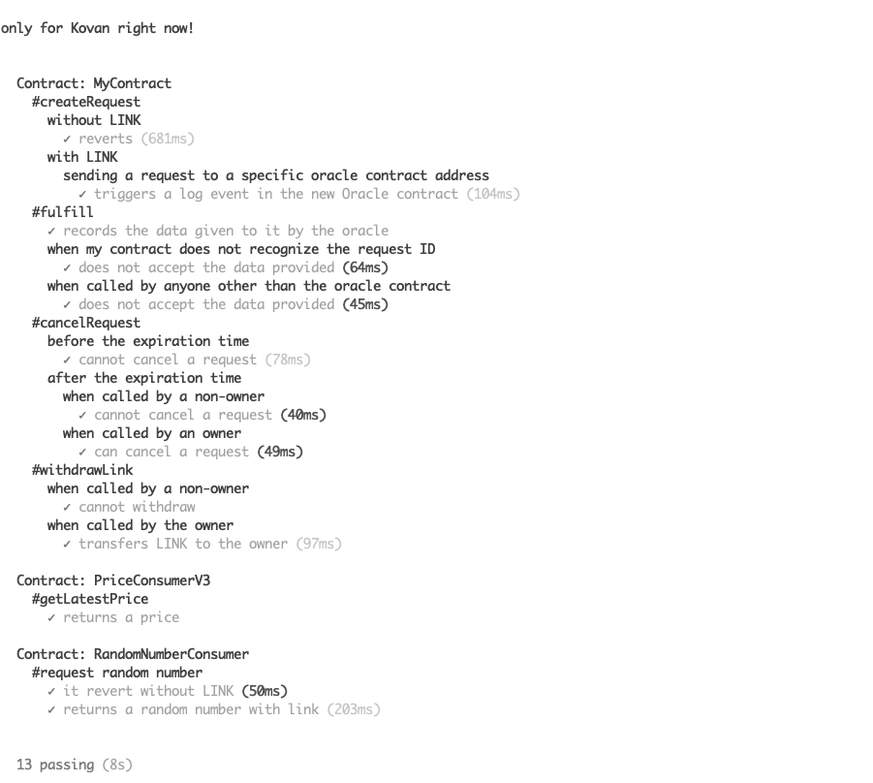
Running tests
Run Ganache or enable/integrate Kovan testnet
npm test
All tests of /test will be executed. There are tests about creating requests with and without Link tokens, sending these requests to oracle contract addresses, and testing contract ownership

Slide 10
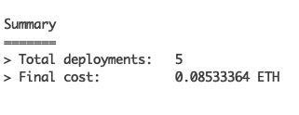
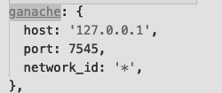
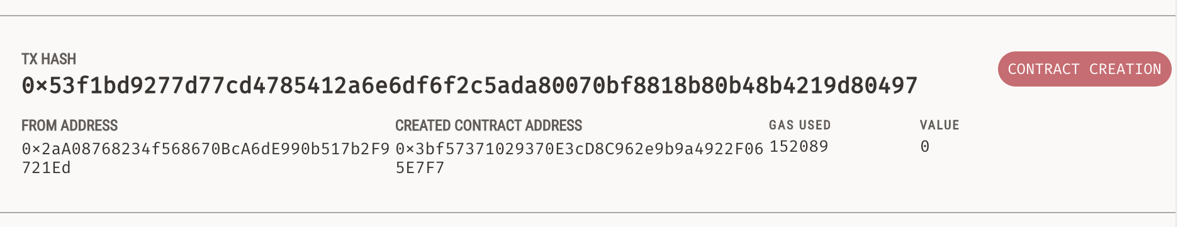
Ganache deployment
Deploy
truffle migrate --network ganache --reset
truffle-config.js
Gas – fee required to conduct a transaction or execute a contract on the Ethereum blockchain.

Slide 11
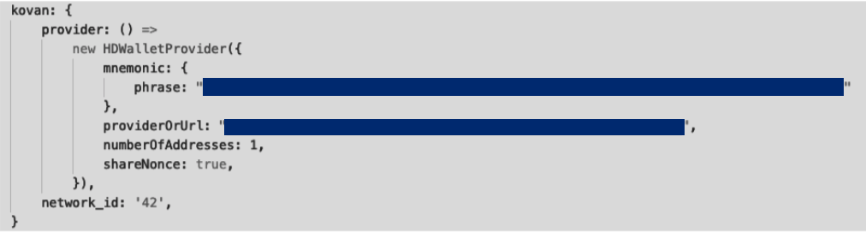
Kovan deployment
Setup Metamask and connect to Kovan network
Faucet: faucet.kovan.network
Create account and a project using Infura.io – step-by-step tutorial
Infura setup and "env.sample" file configuration
truffle-config.js

Slide 12
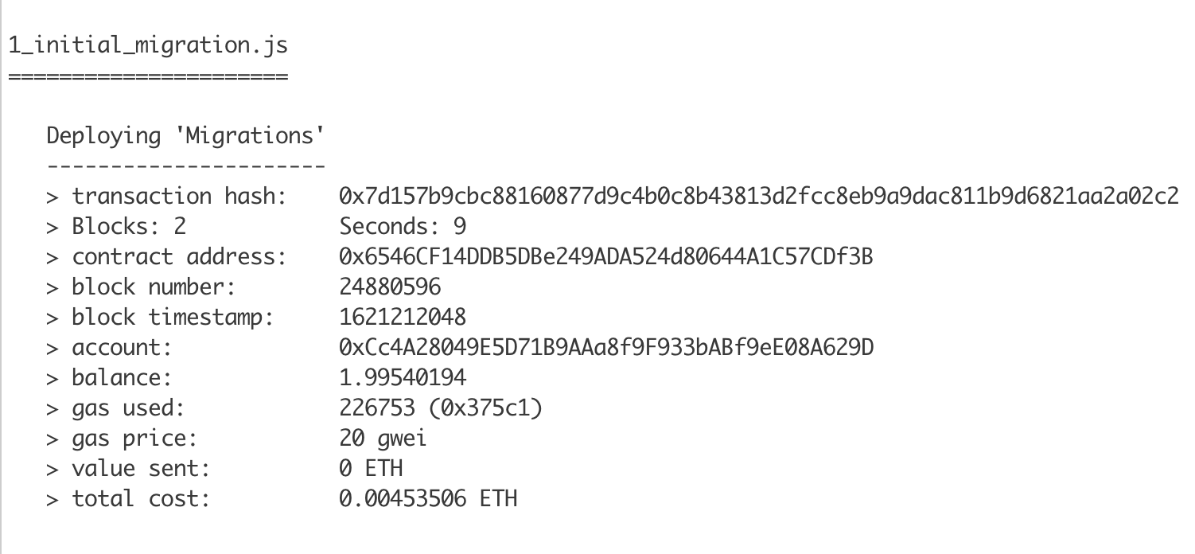
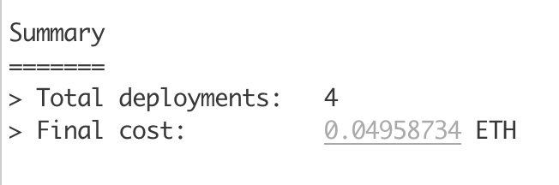
Migration
truffle migrate --network kovan --reset

Slide 13
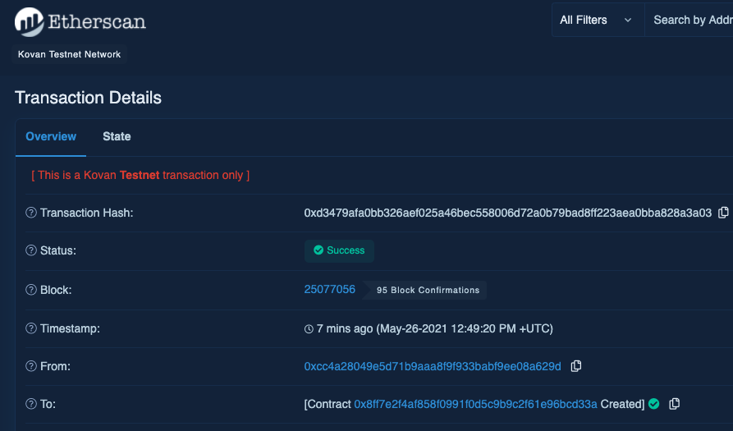
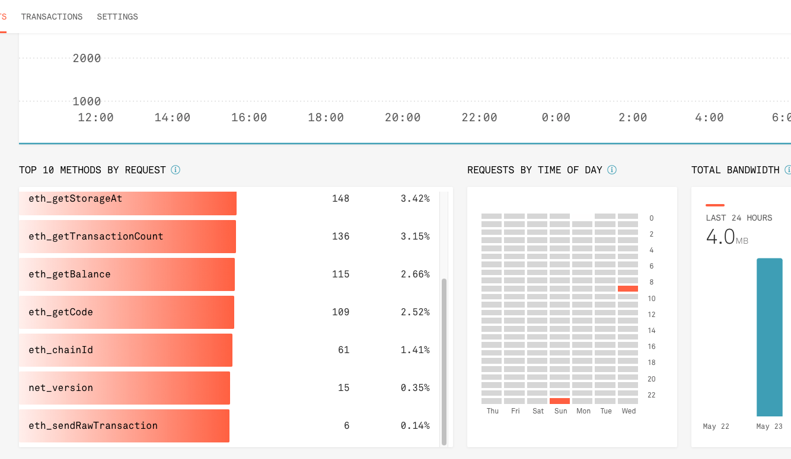
Migration
Etherscan / Kovan
Infura Project

Slide 14

Acquire testnet LINK
Funding contract: 0x1123c6967701ab4a86f7781Fa4E3091383314121
Transaction: 0x0e5447b9f367d76a0bc4c6b9683d4e8d8f7e49c28dc4aeac07ed2e11c0e80d91 exited with an error (status 0) after consuming all gas.
Please check that the transaction:
- satisfies all conditions set by Solidity `assert` statements.
- has enough gas to execute the full transaction.
- does not trigger an invalid opcode by other means (ex: accessing an array out of bounds).
Required: Acquire LINK via Chainlink Kovan Faucet website 🤑 🤑 🤑
Optional: Add LINK token to Metamask - Chainlink docs

Slide 15
Helper scripts
Scripts to interact with deployed smart contract without any frontend implementation:
1. fund-contract.js
npx truffle exec scripts/fund-contract.js --network kovan
2. request-data.js
npx truffle exec scripts/request-data.js --network kovan
3. read-contract.js
npx truffle exec scripts/read-contract.js --network kovan

Slide 16
Helper scripts
fund-contract.js
Send 1 LINK to requesting contract
request-data.js
Chainlink request to be created from the requesting contract
read-contract.js
Read the data variable of the requesting contract (current price of pair ETH/USD)

Slide 17
Additional Information
Top Oracles Tokens by Market Capitalization
Code a REAL WORLD dApp with Chainlink - Ethereum, Solidity, Web3.js
77 Smart Contract Use Cases Enabled By Chainlink
Expanding Beyond Data Delivery With Chainlink 2.0 | Sergey Nazarov at Consensus 2021
Chainlink’s Founder Says DeFi and Oracles Can Help Fight Climate Change
Reversing Climate Change: How Hybrid Smart Contracts Incentivize Regenerative Agriculture

Slide 18
Glossary
ERC-20: technical standard used to issue and implement tokens on the Ethereum blockchain. It makes easier for developers to predict with more accuracy the interaction between different tokens and applications
Faucet: website that distributes small amounts of crypto
ICO: An Initial coin offering occurs when company looking to raise money to create a new coin, app, or service launches an ICO as a way to raise funds. Similar to an IPO
Middleware: software that acts as a bridge between an operating system or database and applications, especially on a network
Off-chain: Transactions which agree to happen outside the blockchain
On-chain: normally refer to as blockchain transactions which happens inside the blockchain

Slide 19
References
Chainlink docs - https://docs.chain.link/docs/tutorials
Chainlink official website - https://chain.link
How to use Chainlink with Truffle - https://blog.chain.link/how-to-use-chainlink-with-truffle-2/
Truffle Starter kit - https://github.com/smartcontractkit/truffle-starter-kit
Truffle Starter kit impl - https://github.com/CryptoDevBR/crypto-feed-chainlink-oracle
What Is Chainlink in 5 Minutes - https://www.gemini.com/cryptopedia/what-is-chainlink-and-how-does-it-work

